Slide 1

SAP Build Training for Corporate Professionals
DAY-2
www.anubhavtrainings.com

Slide 2


DISCLAIMER
The training content and delivery of this presentation is confidential, and cannot be recorded, or copied and distributed to any third party, without the written consent of Anubhav Trainings

Slide 3
Agenda
Hands-on
Setting up SAP BTP Trial account and understanding services
Services
Exploring various SAP BTP Services and understanding BTP environments
SAP Build
Understanding SAP Build offering and services
Build Work zone
Start with SAP Build work zone subscription

Slide 4
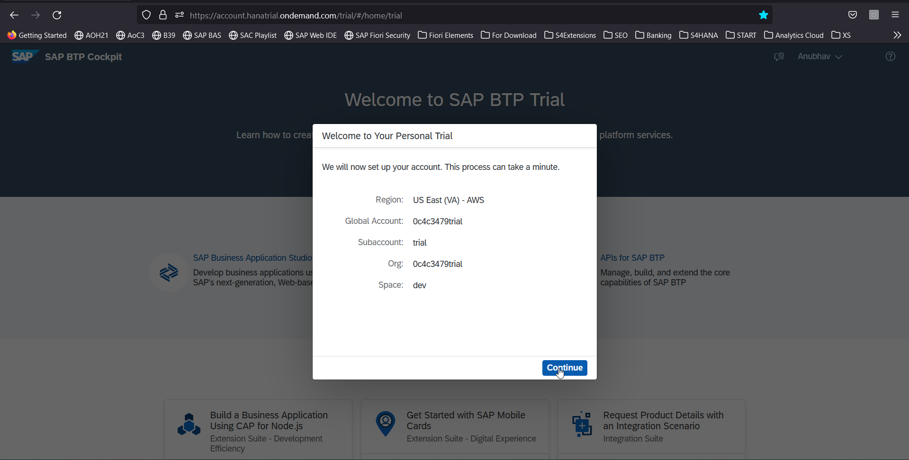
Let’s Create a BTP Account
Create your free BTP Account
https://account.hanatrial.ondemand.com/trial/#/home/trial
What is BTP?
BTP stands Business technology platform, it is a PaaS in the cloud provided by SAP to design, develop, package, build, deliver and manage applications, integrations and business process automation.

Slide 5
BTP Account Structure
Backing Services
Global Account
(Representation of customer for billing purpose)
Sub Account
(per region)
Specialized service offerings
Represents LoB
Space quotas
1 *
1 *
Space
1
*
Apps

Slide 6
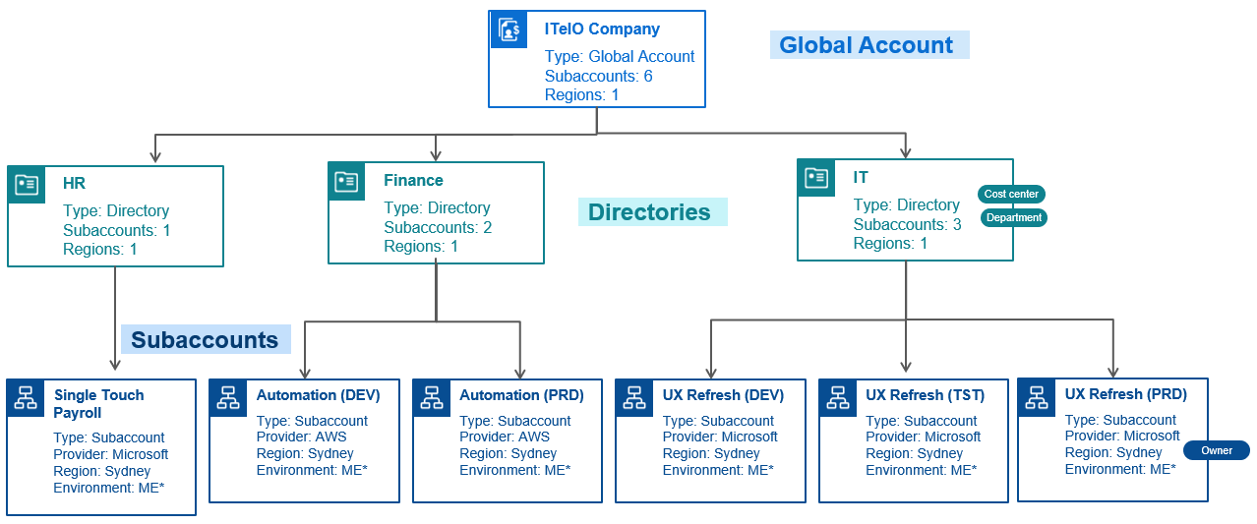
BTP Account – Administrator’s view

Slide 7
BTP Environments, Subscriptions, Instances
Environments
Environments constitute the actual platform-as-a-service offering of SAP BTP that allows for the development and administration of business applications. Environments are anchored in SAP BTP on subaccount level.
SAP BTP offers three environments: ABAP, Cloud Foundry and Kyma. Some existing customers still have Neo, but this is no longer offered.
Subscription based services
You will also see these ones called software as a service (SaaS), or multitenant applications. The experience here is that you subscribe to the service, and in return you receive a URL, from which you can access that service. Opening the URL brings you to a web application from which you can leverage the service. This is how other SaaS like SuccessFactors or S/4HANA Cloud work as well. They are also enabled at a subaccount level, and are independent of the environments. You don’t need to have Cloud Foundry enabled to subscribe to SAP Launchpad Service, for example.
Examples include Launchpad, SAP Business Application Studio, Cloud Integration, Process Automation…
Instance based services
These are the purest services. They provide a specific functionality, like databases, connectivity, authentication…. You connect your application to them to leverage that functionality. These services don’t provide a UI to manage them. Instead, they rely on API to connect to applications and other services and provide their services. They are provisioned inside an environment, so they are environment specific. Each environment has its own organization (for users and applications): In Cloud Foundry, instances are created inside a space. For Kyma, instances are created inside a namespace.

Slide 8
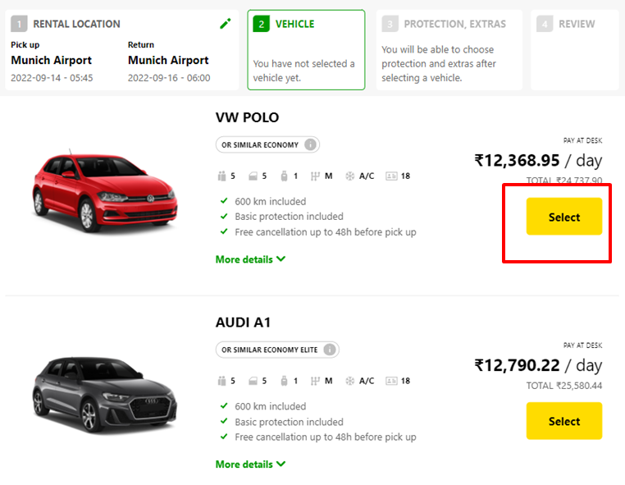
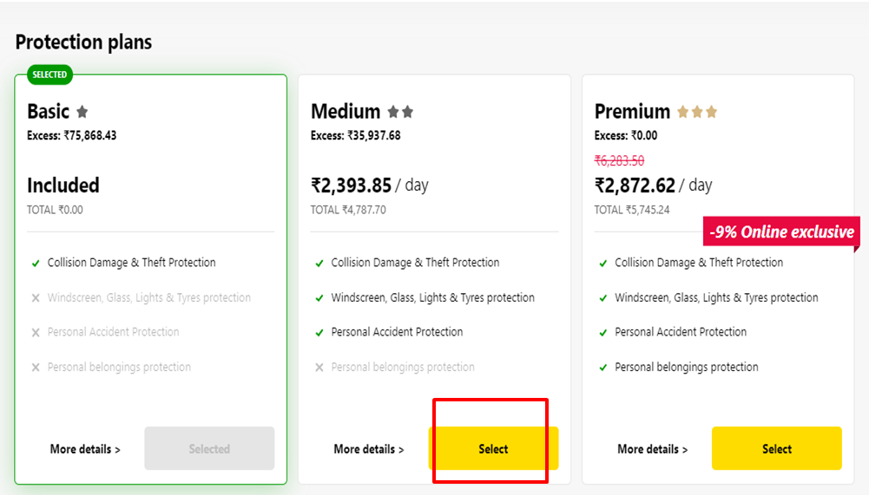
What is Backing service/ service instance
Each service has one or more service plans available. A service plan is the representation of the costs and benefits for a given variant of a particular service. For instance, a database may be configured with various "T-shirt sizes", each of which is a different service plan.
Choose Your service
Backing Service
Select Plan
Service Plan

Slide 9


How the Instance work?
Car key to use Car
Service Key to Consume Service instance
Actual Car
Service Instance

Slide 10
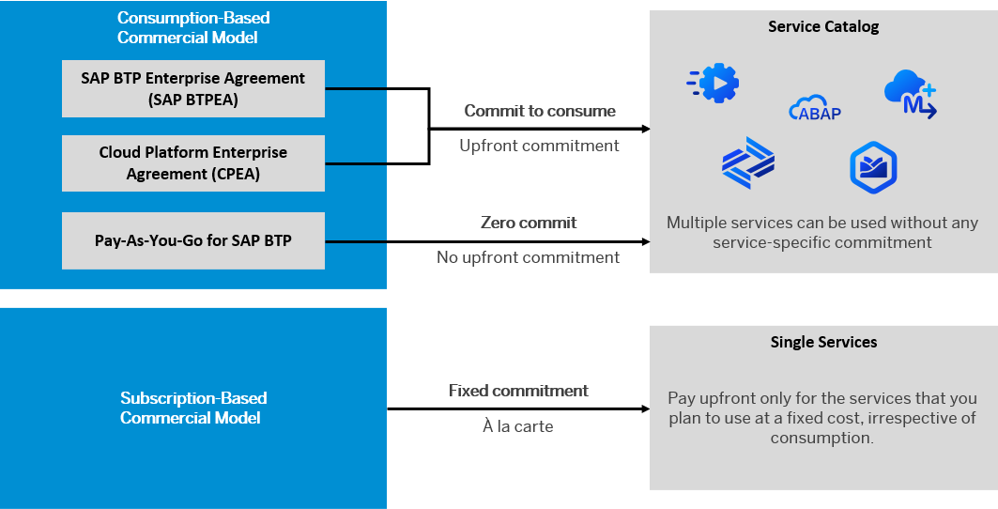
BTP Subscription Models

Slide 11
How many Services BTP offers?
The SAP Discovery Center is a relatively new site hosted by SAP for developers and architects to find the services hosted by sap in SAP BTP and their respective service plans available.
It will also help technical team to identify the data center availability and cost associated with each service.
https://discovery-center.cloud.sap/#/serviceCatalog

Slide 12
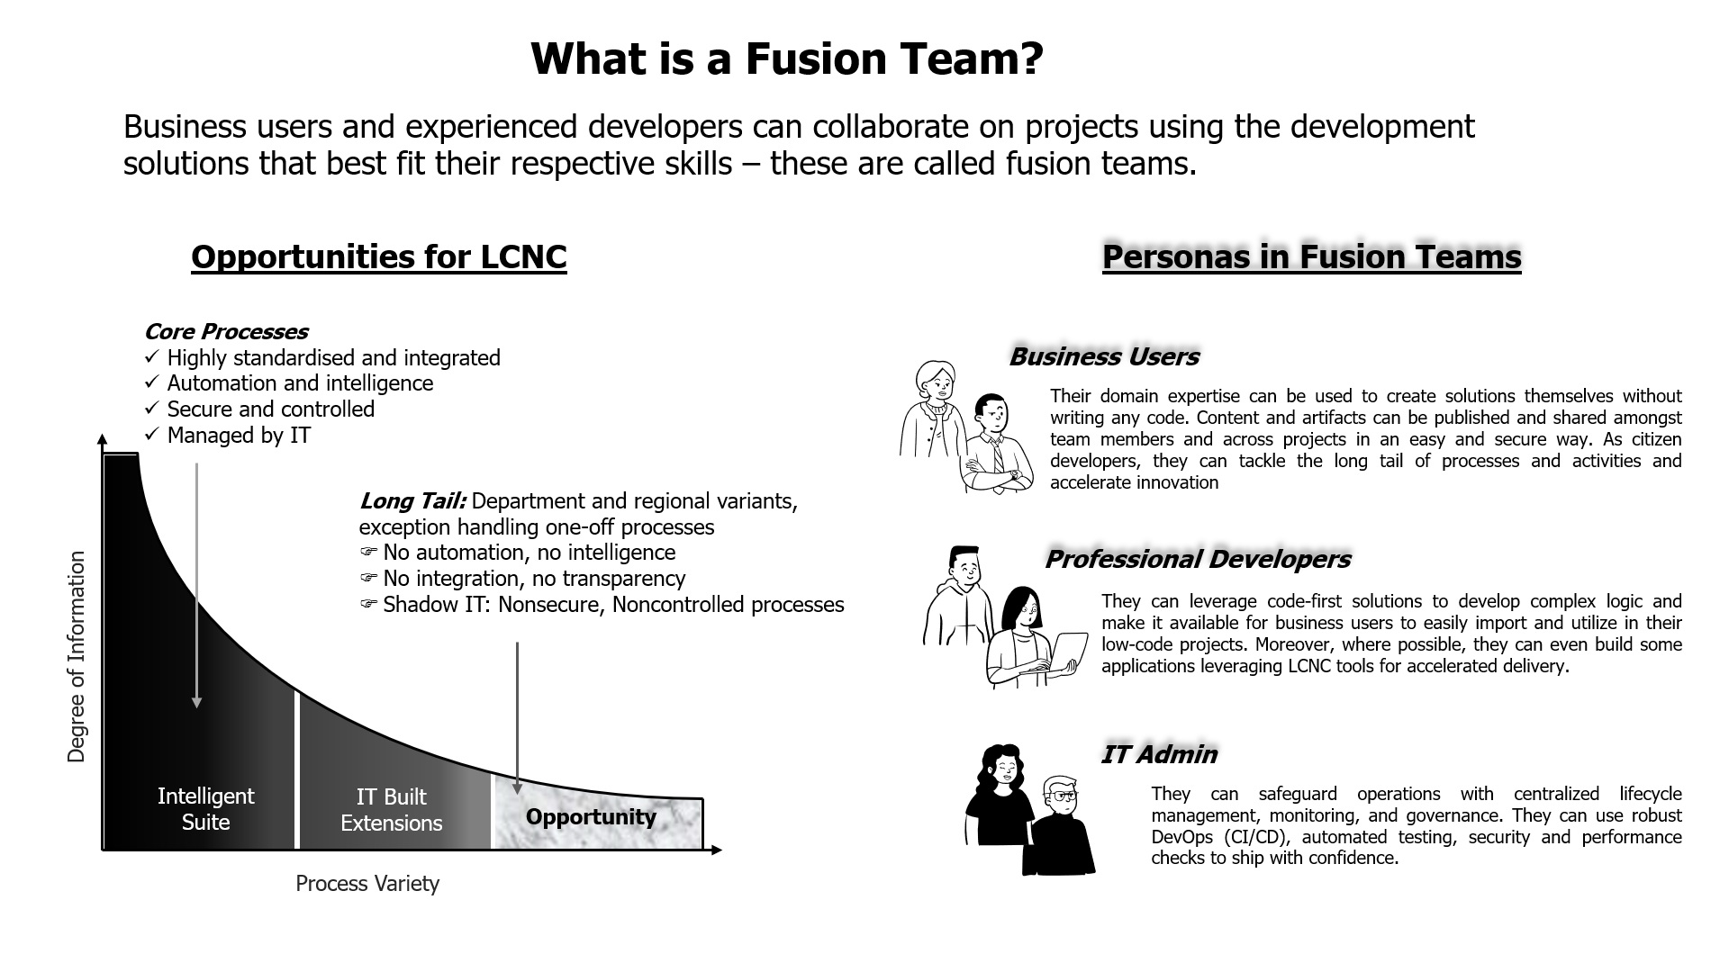
What is fusion Team?

Slide 13
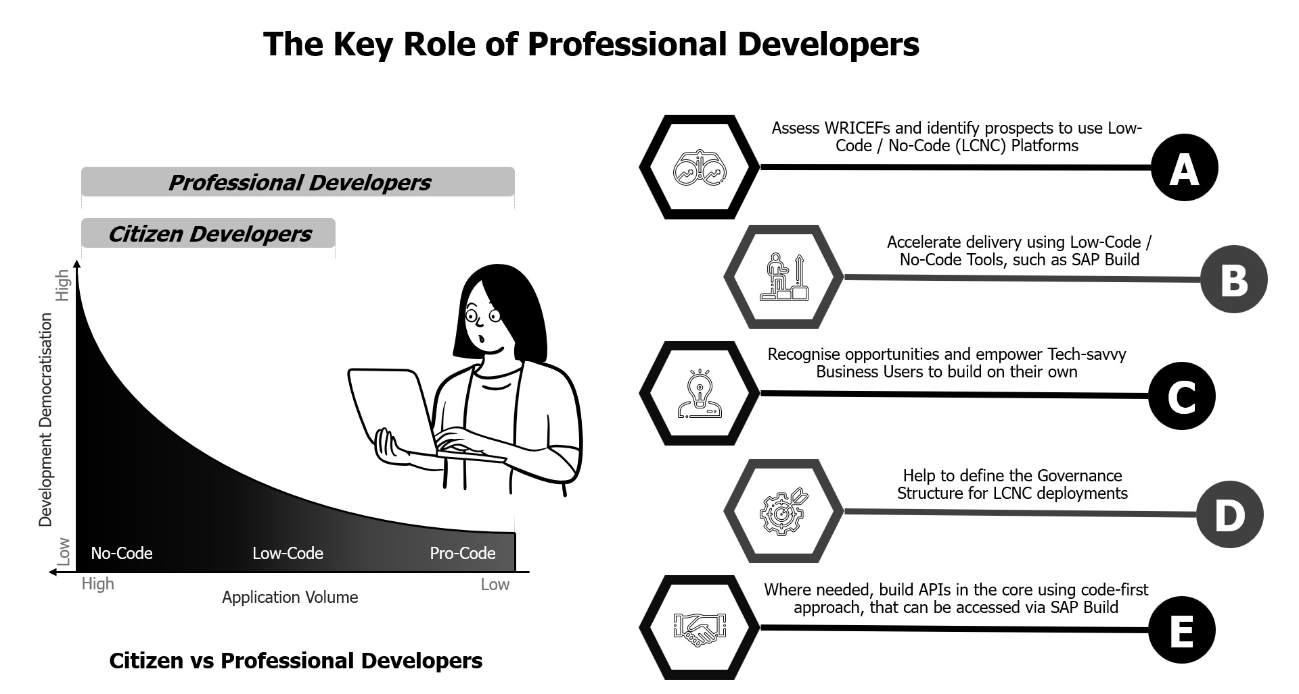
Key role of professional developers?

Slide 14
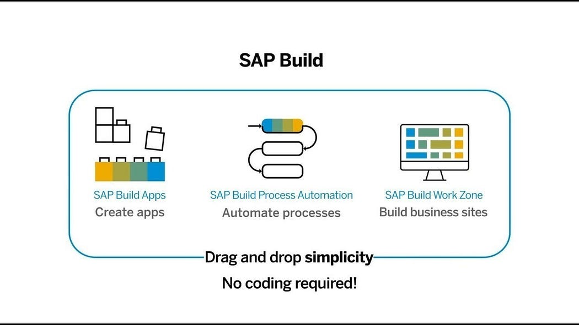
What is SAP Build?
SAP Build is a user-friendly low-code/no-code platform within the SAP Business Technology Platform (SAP BTP), designed to empower users to create, customize, and enhance applications, automate workflows, and build business sites without the need for advanced coding skills. It includes three primary components:

Slide 15
Timeline
BRF +
A webdynpro based rule management application in ERP
iRPA
Robotic process automation with desktop-based application
2000
2019
2022
ECC Workflow
Classic workflows to orchestrate business process
BTP Cloud Workflow
SAP BTP based workflow modeling and execution
SAP Build
Build process automation combining iRPA and Cloud workflow
2006
2020

Slide 16
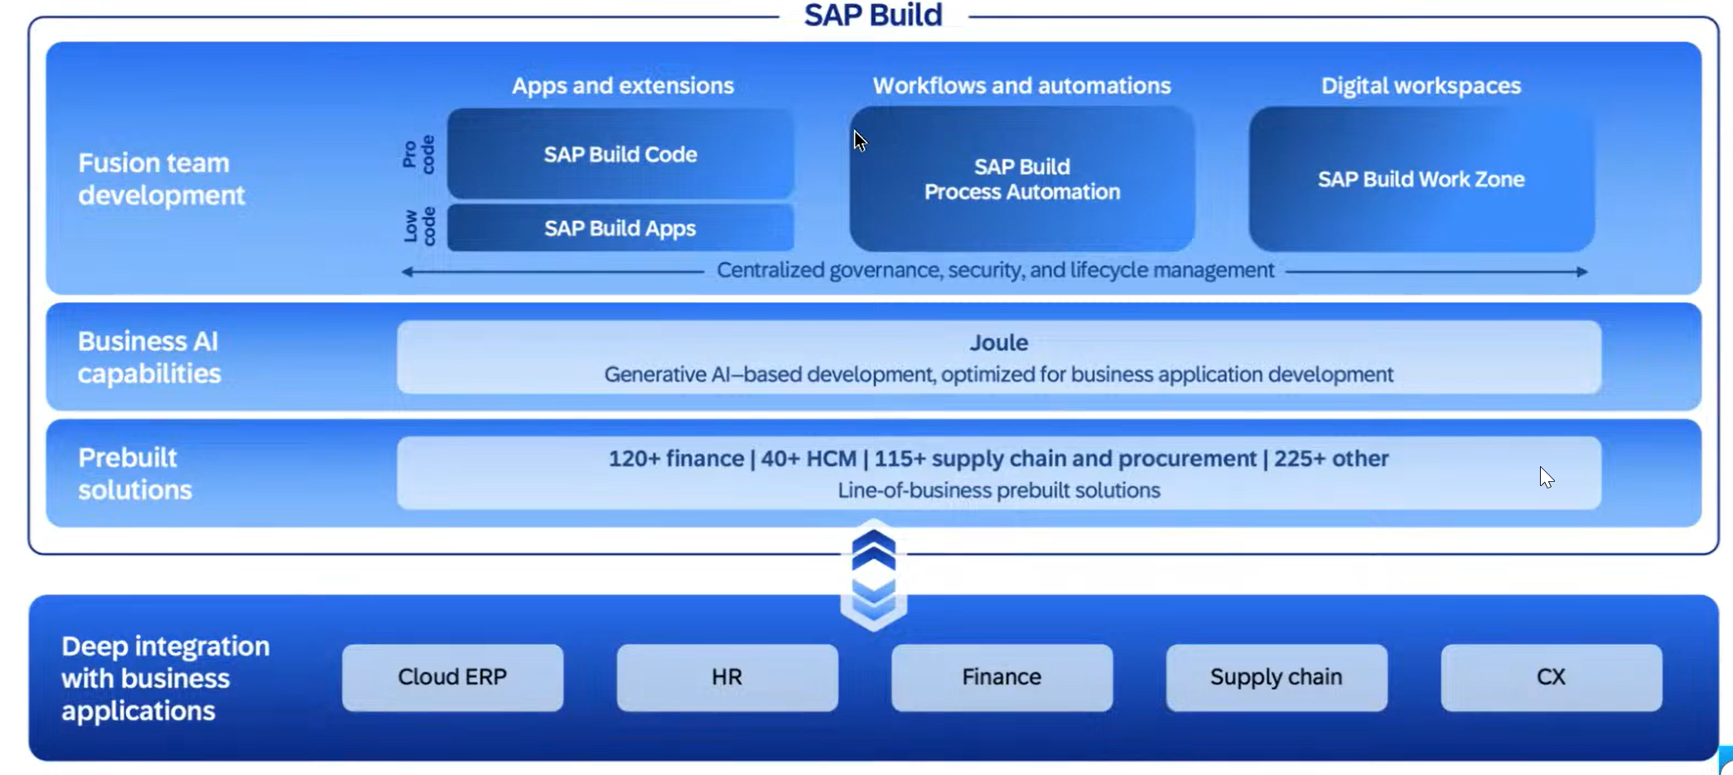
What is SAP Build

Slide 17
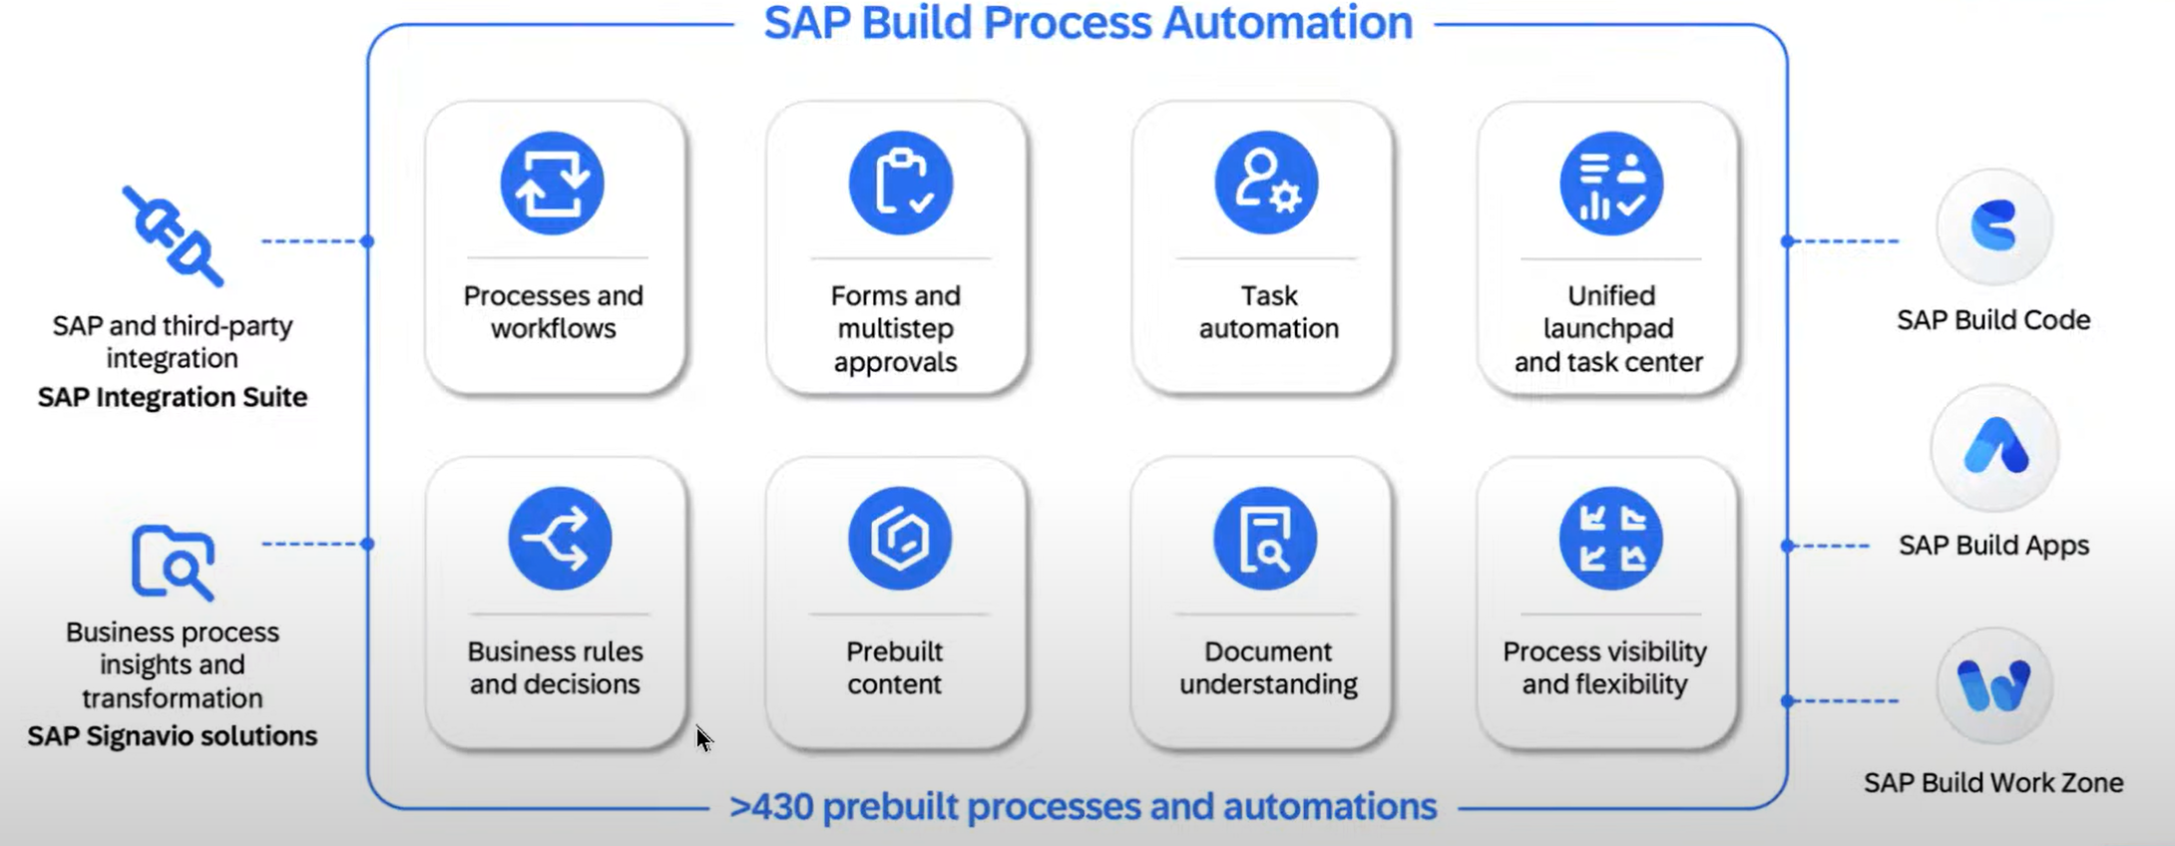
Key Capabilities

Slide 18
SAP Build Offerings?
SAP Build Process Automation
SAP Build WorkZone
SAP Build Apps
Purpose: Simplify the development of enterprise applications through an intuitive interface. Key Features:
Visual Development: Create UI, workflows, and logic using a drag-and-drop approach.
Prebuilt Templates: Leverage templates for common business scenarios.
Data Integration: Connect seamlessly with SAP and external systems through APIs.
Multi-Channel Deployment: Develop apps for both web and mobile platforms.
Collaboration Tools: Facilitate teamwork during the app-building process. Use Cases:
Developing HR onboarding solutions.
Building custom KPI tracking dashboards.
Creating customer-facing applications for feedback collection.
Purpose: Streamline business processes using workflows and robotic process automation (RPA). Key Features:
Workflow Automation: Manage approvals, notifications, and document routing automatically.
Prebuilt Bots: Access a library of bots to handle repetitive tasks like data entry.
Business Rules Management: Easily define and update business logic.
Process Visibility: Track and optimize workflows in real-time.
AI Integration: Utilize AI capabilities such as document recognition for enhanced automation. Use Cases:
Automating invoice approval workflows.
Managing employee leave requests.
Connecting and streamlining repetitive processes across systems.
Purpose: Design tailored business sites and portals for employees, customers, or partners. Key Features:
Prebuilt Templates: Quickly create branded portals.
Content Integration: Combine apps, dashboards, and workflows in a unified portal.
Role-Based Access: Customize content and permissions according to user roles.
Collaboration Features: Incorporate chat, forums, and knowledge-sharing tools.
Mobile-Friendly Design: Ensure accessibility across all devices. Use Cases:
Developing employee self-service platforms.
Creating customer support portals.
Building collaboration hubs for partners.

Slide 19
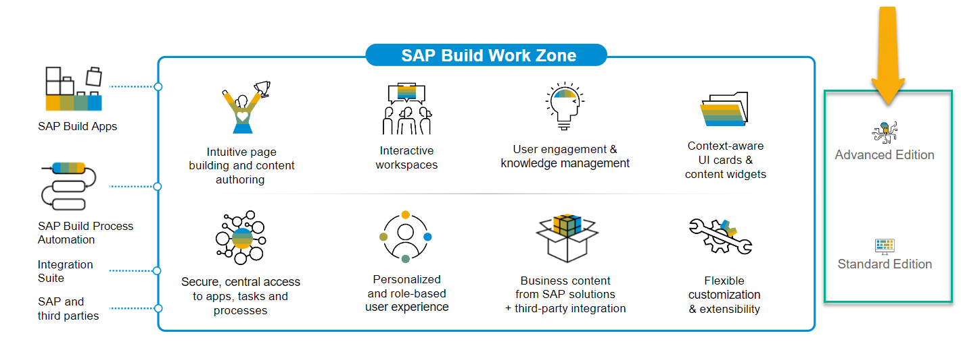
SAP Build Work Zone?
SAP Build Work Zone, advanced edition is a powerful SAP Business Technology Platform service that consists of several components
SAP Launchpad Services is now called SAP Build Work Zone, Standard SAP Work Zone is now called SAP Build Work Zone, Advanced

Slide 20

Hands-on Setting up Build Work Zone

Slide 21
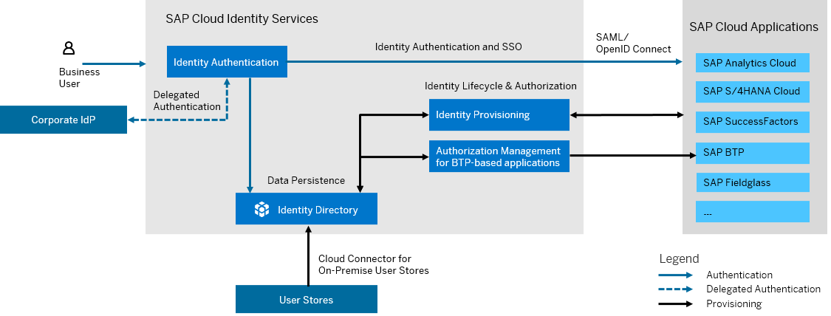
What is SAP Cloud Identity Service?
SAP Cloud Identity Services are a group of services of SAP Business Technology Platform (SAP BTP), which enable you to integrate identity and access management between systems. The goal is to provide a seamless single sign-on experience across systems while ensuring that system and data access are secure. SAP Cloud Identity Services include Identity Authentication, Identity Provisioning, Identity Directory and Authorization Management.

Slide 22
Why we need IAM

Slide 23
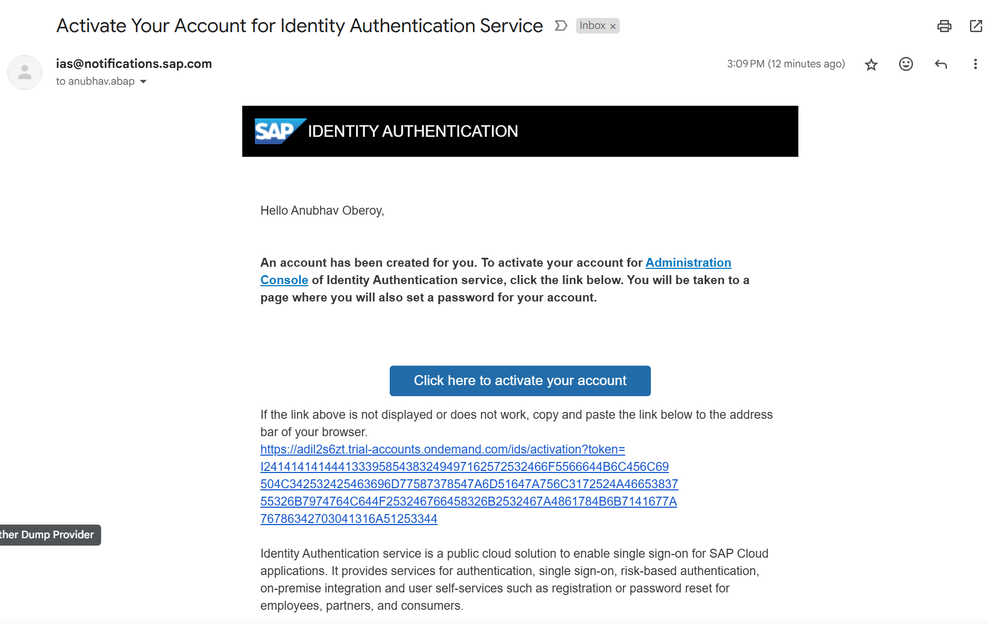
Become Admin for your Identity Service

Slide 24

What We Did
Let’s Summarize
www.anubhavtrainings.com

Slide 25
www.anubhavtrainings.com
Thank You
End of Day 2
www.anubhavtrainings.com

Slide 26



We’re committed to empower you to be
#FutureReady
through powerful training solutions.
We build the workforce of the future.
250+
Corporate Clients
30,000+
Learners Trained
25000+
Learners Placed
FREE WEBINARS
Sign up for free webinars with industry experts every fortnight!
Enroll Now!
Contact us today!
https://anubhavtrainings.com

